Slide 1
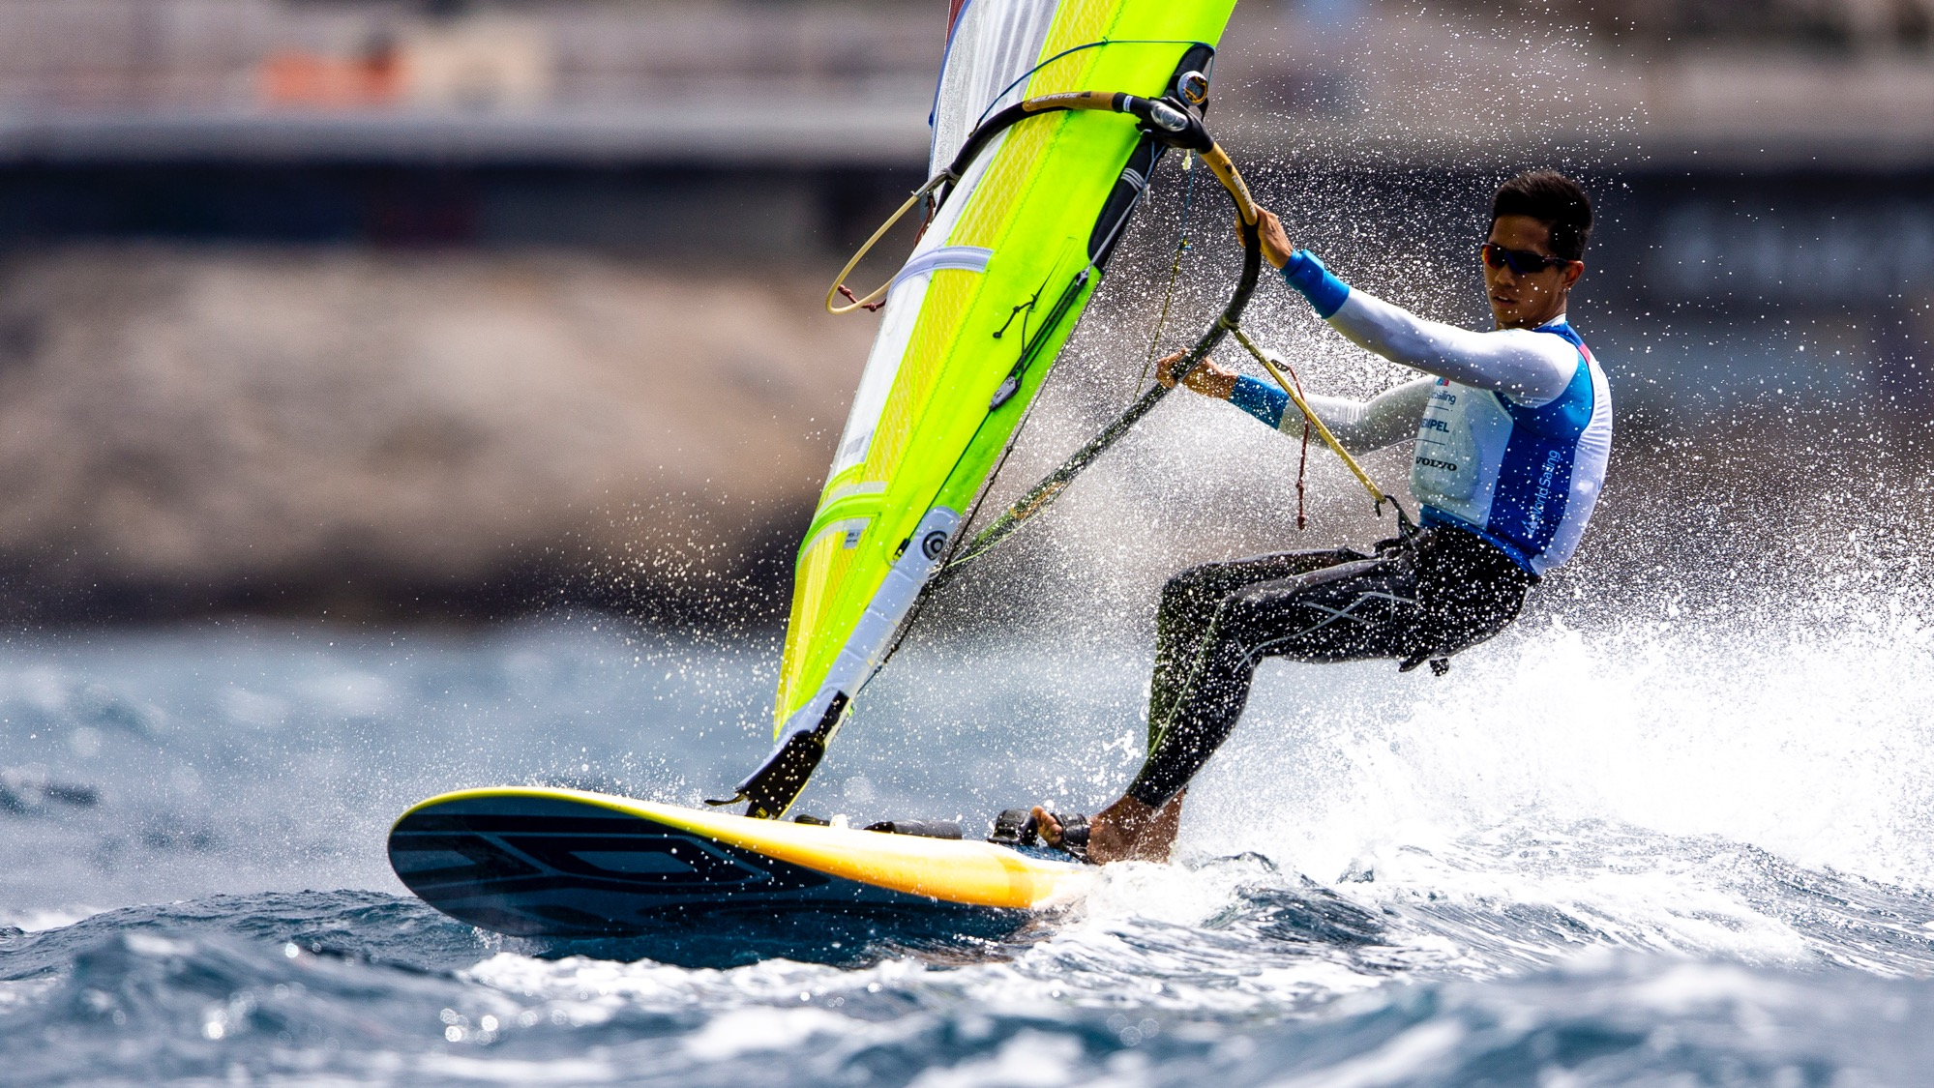
Test
Windsurfing & Kiteboard
Racing Rules
2021-2024

Slide 2
1
The Zone for windsurfing is 2 board lengths.
Wind
False
There is no Zone for windsurfing
Definition Zone is deleted
Rule 18 begins apply between boards when one of them is “rounding or passing”. This is observed when a board begins to maneuver to round or pass the mark.
RRS Appendix B definition ‘Rounding or Passing’
RRS B18

Slide 3
2
There is no Zone for kiteboarding.
Kite
False
There is a Zone for kiteboarding
The area around the mark within a distance
of 30 meters
A kiteboard is in the zone when any part of her
hull is in the zone

Slide 4
3
Windsurfing boards are permitted to slow down by dropping their sail into the water when approaching to start.
Wind
False
In the last minute before her starting signal,
a board shall have her sail out of the water and in a normal position, except when accidentally capsized.
RRS B23.3

Slide 5
4
If a kiteboard clear astern becomes overlapped within two
of her hull lengths to leeward of a board on the same tack,
she may sail above her proper course.
Kite
True
Rule 17 is deleted.
RRS F17

Slide 6
5
RRS 17 is deleted also for windsurfing.
Wind
False
The RRS 17 applies but it is changed by Appendix B.
When at the warning signal, the course to the first mark is approx. 90 degrees (reaching start) from the true wind, a board overlapped to leeward of another board on the same tack during the last 30 sec. before her starting signal shall not sail above the shortest course to the first mark while they remain overlapped if a result the other board would need to take action to avoid contact, unless in doing so she promptly sails astern of the other board.

Slide 7
6
RRS 18.3 – “Tacking in the Zone” is not
applicable for windsurfing.
Wind
True
Rule 18.3 is deleted - RRS B18.3

Slide 8
7
RRS 18.3 – ”Tacking in the Zone” is deleted for
kiteboarding as it is not applicable for them.
Kite
False
The RRS 18.3 (Tacking and Gybing) applies but it is changed.
When an inside overlapped right-of-way kiteboard must change tack at a mark to sail her proper course, until she changes tack she shall sail no farther from the mark than needed to sail that course.
RRS 18.3 does not apply at a gate mark or a finishing mark
A kiteboard shall not be penalized for breaking this rule
unless the course of another kiteboard was affected by
the breach of this rule.

Slide 9
8
At the windward mark, an inside overlapped right-of-way board is not required to bear away to sail to the downwind mark which is her proper course to sail.
Wind
False
When an inside overlapped right-of-way board must gybe or bear away at the mark (except at a gate mark) to sail her proper course, until she gybes or bears away she shall sail no farther from the mark than needed to sail that course.
RRS B18.4

Slide 10
9
When a board touches a mark she must take a 360°
Turn Penalty with no requirement for tacks or gybes.
Wind
False
Boards are permitted to touch a mark but shall not hold on to it.
RRS B31

Slide 11
10
When a kiteboard touches a windward mark while racing,
she must take a penalty.
Kite
True
While racing, a kiteboard shall not touch a windward mark
RRS F31

Slide 12
11
When a board is breaking rule of Part 2 she may take a
One-Turn Penalty which includes one tack and one gybe.
Wind
False
RRS 44.2 is changed, so that Two-Turns Penalty is replaced by a 360°-Turn Penalty with no requirement for tack and gybe.
RRS B44.2

Slide 13
12
When a kiteboard is breaking rule of Part 2 she may take
a One-Turn Penalty by her hull appendage in the water, which includes also one tack and one gybe.
Kite
True
RRS 44.2 is changed, so that Two-Turn Penalty is replaced by One-Turn Penalty and the turn shall be made with her hull appendage in the water.
Also the turn shall include one completed tack and
one completed gybe.
RRS B44.2

Slide 14
13
A board that breaks a rule of Part 2 while
racing may exonerate herself by promptly taking
a 360°- Turn Penalty by board only.
Wind
True
A board may take a 360°-Turn Penalty if she did not cause injury or serious damage or gain a significant advantage by her breach.
RRS B44.1.

Slide 15
14
To protest a board for an incident in the racing area, a board shall hail “Protest” and raising her hand.
Wind/Kite
False
The board needs only to hail “Protest” at the time; there is no requirement to raise a hand.
Windsurfing RRS B61.1(a)
Kiteboarding RRS F61.1(a)

Slide 16
15
A protest by a board is invalid without informing the race committee as soon as practicable after she finishes or retires.
Wind
True
A board shall also inform the race committee of her intention to protest as soon as practicable after she finishes or retires.
RRS B61.1(a)

Slide 17
16
The requirement for a board to report a protest to the race committee must be written in the Sailing Instructions.
Wind
False
The requirement to inform RC is written in rules and need not be repeated in the SI’s.
RRS B61.1(a)

Slide 18
17
The requirement for a kiteboard to report a protest to the race committee must be written in the Sailing Instructions.
Kite
True
The requirement to inform RC is not written in rules for Kiteboards so to apply this rule, it shall be written in SI’s.

Slide 19
18
A windsurfing board is capsized when
the top of mast is in the water.
Wind
False
A board is capsized when she is not under control because her sail or competitor is in the water.
RRS Appendix B Definition Capsized.

Slide 20
19
A kiteboard is not capsized when her lines of kite are tangled with another kiteboard’s lines, but the kite has not yet fallen into the water.
Kite
False
A kiteboard is capsized when
  Her kite is in the water.
  Her lines are tangled with another kiteboard’s lines.
RRS Appendix F Definition Capsized.

Slide 21
20
A kiteboard finishes when any part of her hull or the competitor crosses the finishing line from the course side, even when competitor is not in contact with the hull.
Kite
False
A kiteboard finishes when, while the competitor is in contact with the hull, any part of her hull, or the competitor, crosses the finishing line from the course side.
RRS Appendix F Definition Finish.

Slide 22
21
A board is entitled to redress when she capsizes because
of the action of a board that was breaking a rule of Part 2, even if there is no damage or injury.
Wind
True
A board is entitled to redress when she capsizes because of the action of a board that was breaking
a rule of Part 2 and took the appropriate penalty or
was penalized
RRS B62.1(b)

Slide 23
22
A kiteboard is entitled to redress when she capsizes because of the action of a kiteboard that was breaking a rule of Part 2, even if there is no damage or injury.
Kite
False
A kiteboard is not entitled to redress just for a capsize.
A ’standard’ RRS 62.1(b) applies

Slide 24
23
At windsurfing and kiteboarding events, when it is
stated in the Sailing Instructions, the Race Committee
may give oral instructions ashore.
Wind/Kite
True
For both windsurfing and kiteboarding events RRS 90.2(c) is changed to, “Oral instructions may be given only if the procedure is stated in the sailing instructions.”
Windsurfing RRS B90.2(c)
Kiteboard RRS F90.2(c)

Slide 25
24
In a Windsurfing race in light wind a competitor may lay on the board and paddle with their hands to finish the race.
Wind
False
A board shall not be propelled by paddling, swimming or walking.
RRS B42

Slide 26
25
To break a tie in the series-score between two or more
windsurfing boards, the first option is use their best excluded score.
Wind
True
Windsurfers start to break ties by ranking boards in order of their best excluded race score.
RRS Appendix B A8.1

Slide 27


